Slide 1
Welcome talk
Year 3 2023-2024

Slide 2
The Y3 Team
Teachers:
3K – Miss Keane (Ms Zelynskyj – Wednesday PM)
3S – Miss Stubbs
Teaching assistants:
Mrs Bradford
Mrs Davie

Slide 3

Structure of the school day
Children settle straight into the school day at 8.55 with morning maths (4-a-day). Its important children arrive on time to school so they don’t frequently miss this session. 4-a-day really supports children with their maths.
The morning will usually consist of English and Maths lessons.
There are no afternoon playtimes in KS2 but the children will have an opportunity to have a drink and use the toilet mid-way through the afternoon.
Afternoons are very short! We have less than two hours to complete two wider curriculum subjects, so we have to ensure children keep up with the pace of lessons.
At the end of the day, children will be brought to the playground with their class teacher. Once they have seen their adult, they must inform their class teacher before leaving.

Slide 4
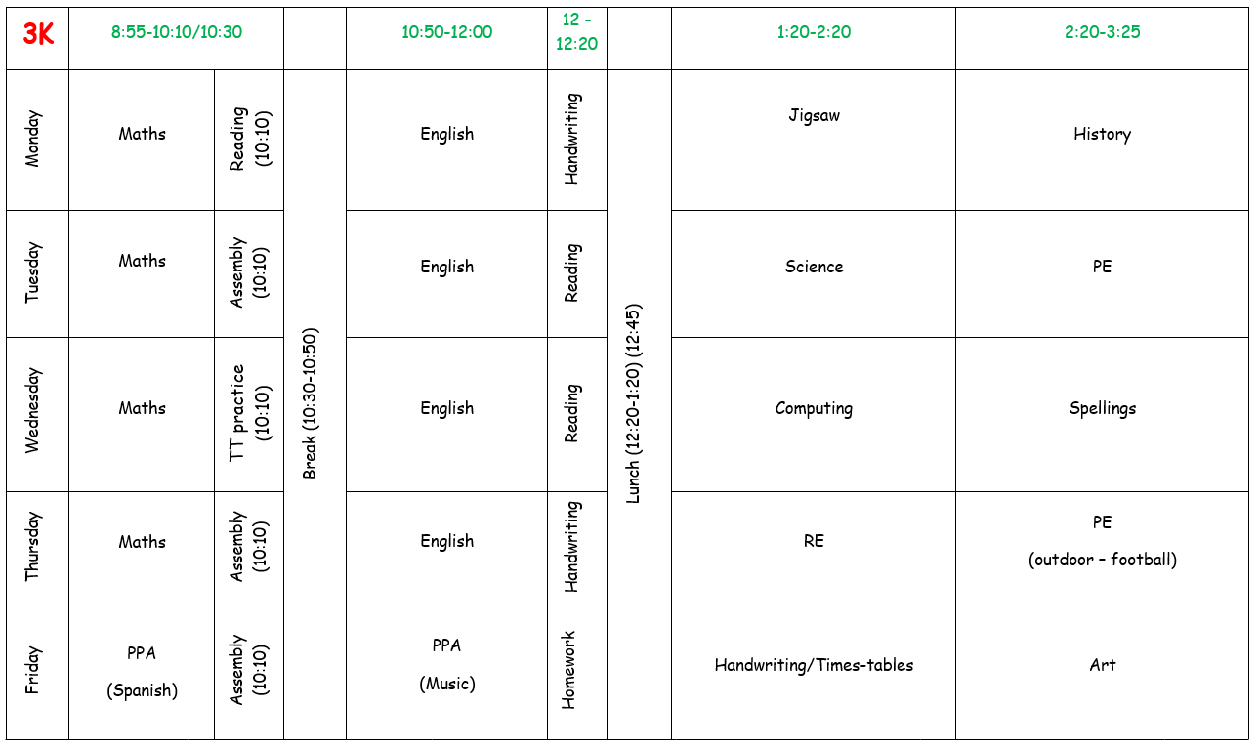
A typical week in year 3…

Slide 5
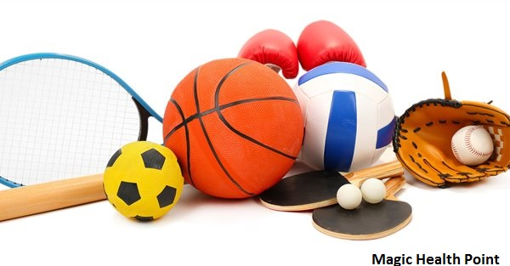
PE
The children will participate in two PE lessons a week.
Children need to wear their PE kit on the correct days. These days may change throughout the year and may vary between the two year 3 classes at times. Texts will be sent to parents whenever a PE day changes.
Appropriate PE uniform must be worn – we do PE whatever the weather! The correct uniform policy has been sent out at the end of last year.
Swimming counts as 1 PE lesson.
In Autumn 1, PE for both classes will be on TUESDAY and THURSDAY.

Slide 6
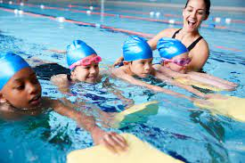
Swimming
In year 3, children start school swimming lessons!
The children in 3HS will go first (starting in Autumn 2) and swim every Thursday for a 8 week block. After this, 3K will start.
Letters with dates and information will be sent out nearer the time.
We swim at the Portland Pool on Thursday afternoons, travelling to and from the centre on a bus. Children will be back at school before the end of the school day.
Notts Council recommend that goggles are not needed for the sessions, however If you would like your child to wear goggles, you must return the goggles form to school (the instructors will not allow children to wear goggles without the consent form being signed).
Children need to be able to get undressed and redressed independently!
No bikini’s and no pockets in boys trunks. No long, baggy, board shorts.
We will need volunteers for this to happen!

Slide 7

Photo permission
We regularly update our class pages on the school website to share events and activities with you throughout the year.
Due to GDPR regulations we aren’t able to use your child’s photo image without your permission.
You can check or update this at the office.
Unfortunately, if we do not have consent, we will have to ask children to stand out of group photos.

Slide 8

Reading
We expect the children to read at home at least 4 times a week. This needs to be recorded in their Reading Diaries.
Before Christmas, we will take the opportunity to listen to the children read in groups whilst the rest of the class read silently.
After Christmas, children will begin our structured reading lessons in line with the rest of the juniors. This works like a rotating carousel where children will have time to complete comprehension questions, read with an adult and read on their own.
Children that need extra support with reading will be read with weekly (and in some cases daily) by the class teacher, TA or reading volunteer.
Children will have an individual book band colour and are now responsible for changing their own books at the start and end of the day or during independent reading sessions.

Slide 9
Reading Diaries
Children have been sent home with a new Reading Diary.
As well as being somewhere to log reading at home, they have lots of useful information in them to help support your child’s learning. (Times tables, statutory year 3 spelling list, common homophones etc.)
Diaries need to be in school every day.
There is a space for children to stick in their and there is space for any messages from home.
If you do write a message in your child's diary, please encourage them to show it to the teacher as diaries are checked fortnightly.

Slide 10
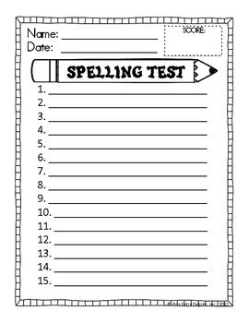
Spellings
Children will be given a list of spellings to learn every Wednesday. These will be stuck into their Reading Diaries to practise at home.
They will then be tested on their spellings in the following weeks spelling lesson.
Some children may be given additional or differentiated spellings to practise to increase their confidence in spelling high frequency words.
Following last years success, children will complete their spelling test in their reading diaries so you can keep up-to-date with their spelling test scores.

Slide 11
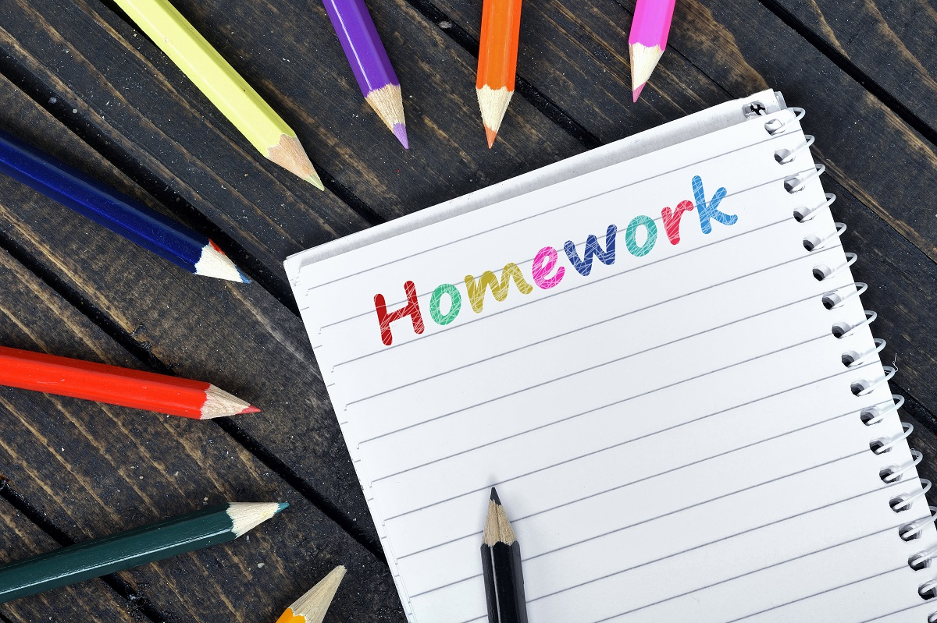
Homework
Children have been given homework books. We would encourage these to be covered or decorated.
Homework will be handed out on a Friday and will be due in by the following Thursday unless otherwise stated.
We encourage parental involvement with homework and see this as an opportunity for a child to share their learning.

Slide 12
Helping out at home
Please help at home by learning to tell the time on an analogue and digital clock.
Please ensure you practise times tables regularly at home. By the end of Year 3 children are expected to have a secure knowledge of multiplication facts for the 2,3,4,5 8 and 10 times tables.
There is a now national statutory times table test on all times tables up to 12 x 12 at the end of Year 4, so the more the children can secure now the better!
We have bought a school account for Times Table Rockstars which the children can also use at home. Each child has their own login details. TT Rockstars uses a similar format to the statutory test.
Please ensure your child is reading at home at least 4 times a week. We encourage a range of texts and genres to keep them engaged and enjoying reading. As the children become more confident at reading words, they need to be able to understand the text at a deeper level and be able to answer questions using inference and deduction and explain their understand of the vocabulary used.

Slide 13
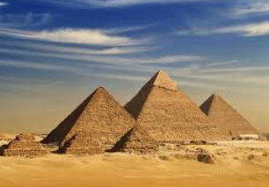

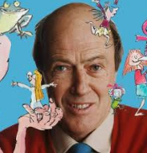
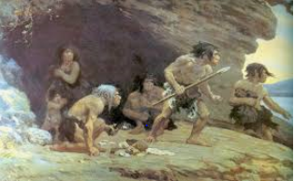
Topics
History/Geography Topics
Ancient Egypt
The Mediterranean
Prehistoric Ages (focusing on the Stone Age)
Roald Dahl
Science Topics
Plants
Forces and Magnets
Rocks and Fossils
Animals and Humans
Light and Shadow

Slide 14

Additional notes
Throughout the year the children will participate in a range of sports trips, educational visits and immersion days in school. These will be confirmed nearer the time.
Due to an extremely busy timetable, there is no allocated time for show and tell this year! However if your child has a notable or special achievement or award, they can share this in dragons assemblies on a Friday morning.
You will be aware that fruit and milk is no longer provided for free for junior children. If you would like your child to have fruit or milk you can order it at the office.
Children can bring in a piece of fruit or a cereal bar from home to eat at playtime. Playtime snacks MUST be healthy.

Slide 15
We welcome you to Year 3 where we wish to work in partnership with you and your child to ensure a happy and productive school year.
Best Wishes
The Year 3 Team

Slide 16
Changes from year 2 (recap)
No afternoon break.
Higher expectations, the work gets harder and we have more to fit into each day.
Swimming lessons.
Children are now ‘juniors’ and in key-stage two.
No show and tell – but we have the BFG!

